Slide 1

ElectroHub Retail Sales & Profitability Analytics Dashboard
Business Intelligence Solution for Sales, Profitability & Regional Performance Analysis
POWER BI
SQL SERVER
POWER QUERY
DAX

Slide 2


Business Overview & Problem Statement
About ElectroHub
A multi category retailer spanning 8 product lines — Electronics, Clothing, Footwear, Home Appliances, Accessories, Kitchenware, Bags, and Personal Care.
Business Challenges
Expected Outcome: Centralized BI dashboard enabling data driven decision-making.
No centralized reporting across categories
Limited visibility into sales & profitability
No discount impact or regional analysis

Slide 3
Project Workflow
End to end pipeline from raw CSV sources to production grade business insights, validated through a structured test to production deployment.
01
02
CSV Data Sources
SQL Server
03
04
ElectroHub_Test Environment (300 Records)
Power Query Transformations
05
06
Star Schema Data Model
DAX Measures
07
08
Dashboard Development
Validation & Testing
09
10
ElectroHub_Prod Environment (3000+ Records)
Business Insights
4
300+
3000+
Data Tables
Test Records
Production Records

Slide 4
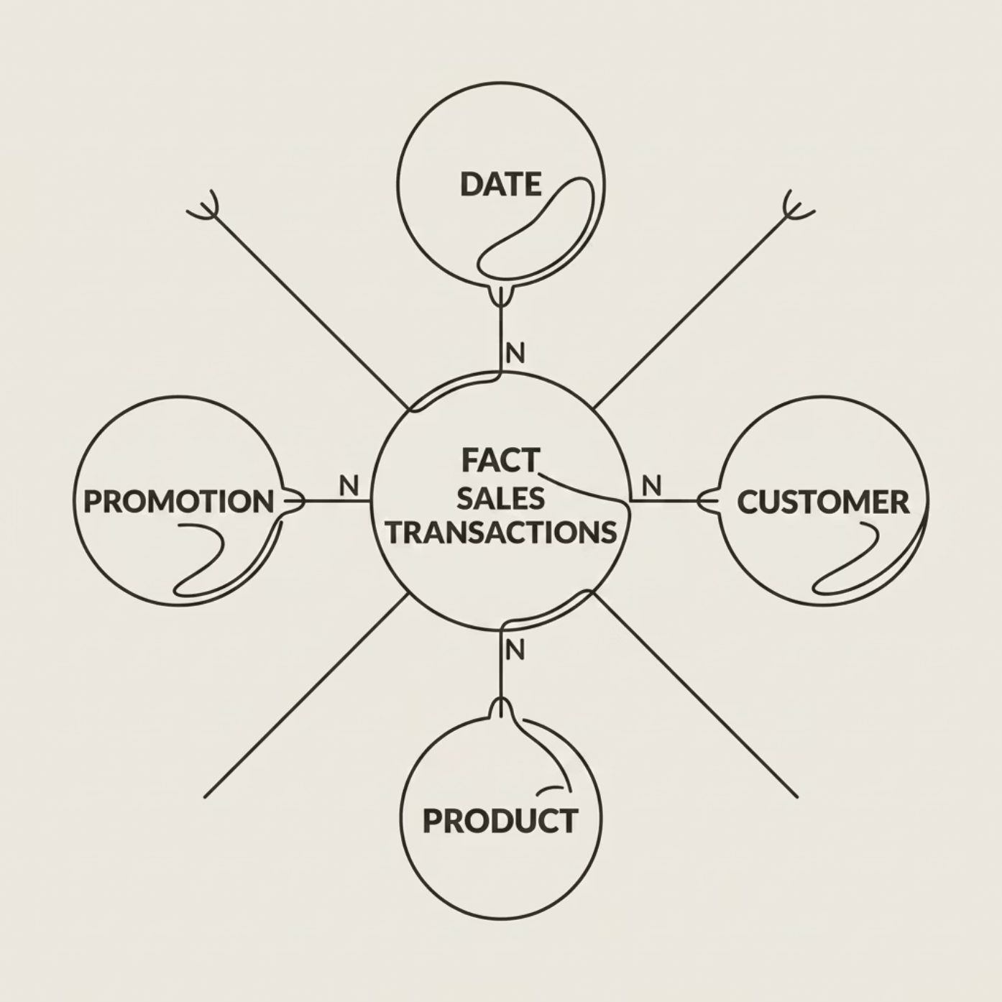
Data Preparation & Modeling
Star Schema Data Model
Dataset Structure
Key Transformations
Data type validation & missing value handling
Discount extraction & merge operations
Net sales & profit calculations
Customer
Product
Promotion
Sales Transactions

Slide 5
Dashboard Overview
Interactive Power BI dashboard built for real-time business performance monitoring and executive decision support.
Total Sales
Net Sales
Gross revenue across all categories
Revenue after discount adjustments
Total Profit
Total Orders
Aggregate margin after costs
Transaction count across periods
Quantity Sold
Avg. Discount
Units moved across all products
Promotional impact on net revenue

Slide 6
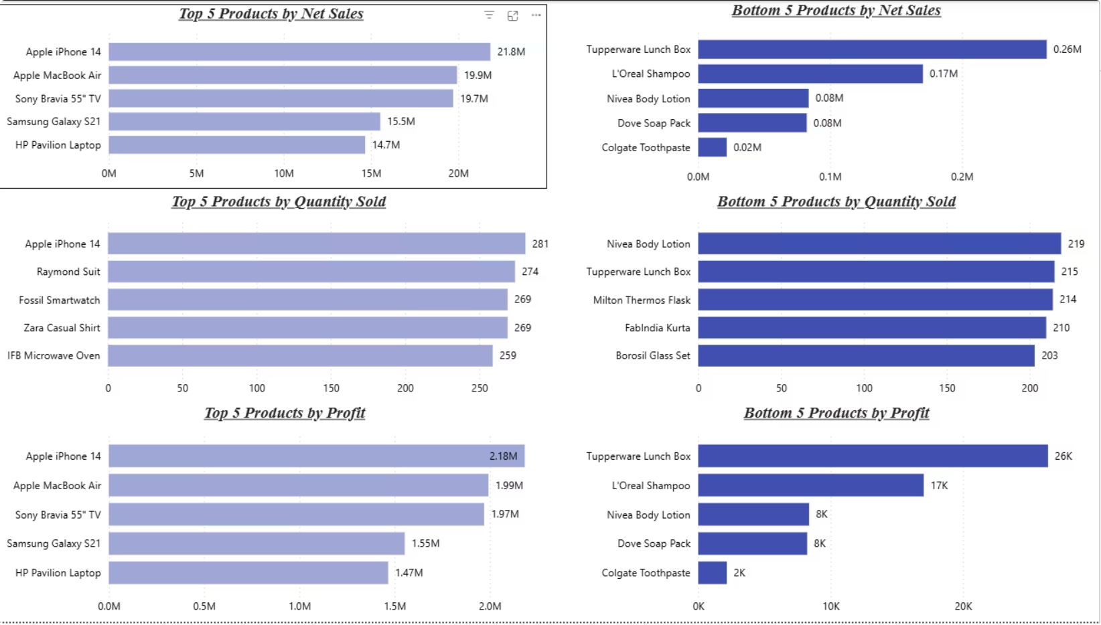
Product Performance Analysis
Product Rankings
🏆 Top Product by Sales
💰 Top Product by Profit
Apple Iphone 14(21.8M)
Apple Iphone 14(2.18M)
📦 Highest Quantity Sold
📉 Lowest Performing Product
Apple Iphone 14(281)
[Tupperware LunchBox(26k)

Slide 7
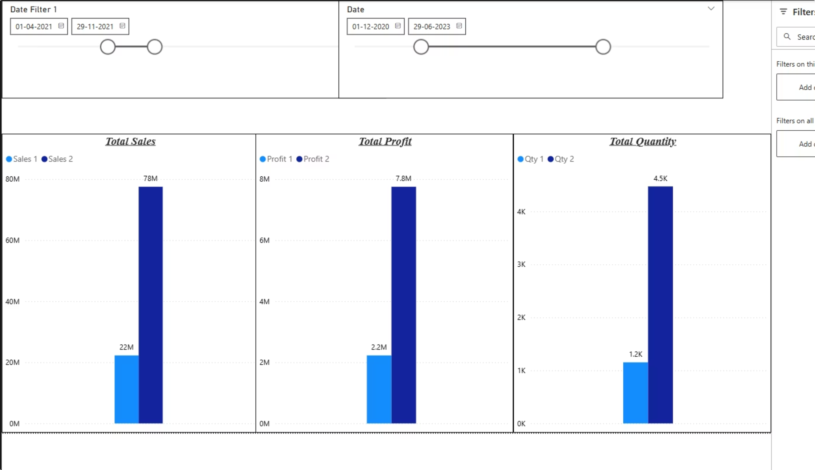
Sales & Profitability Insights

Slide 8
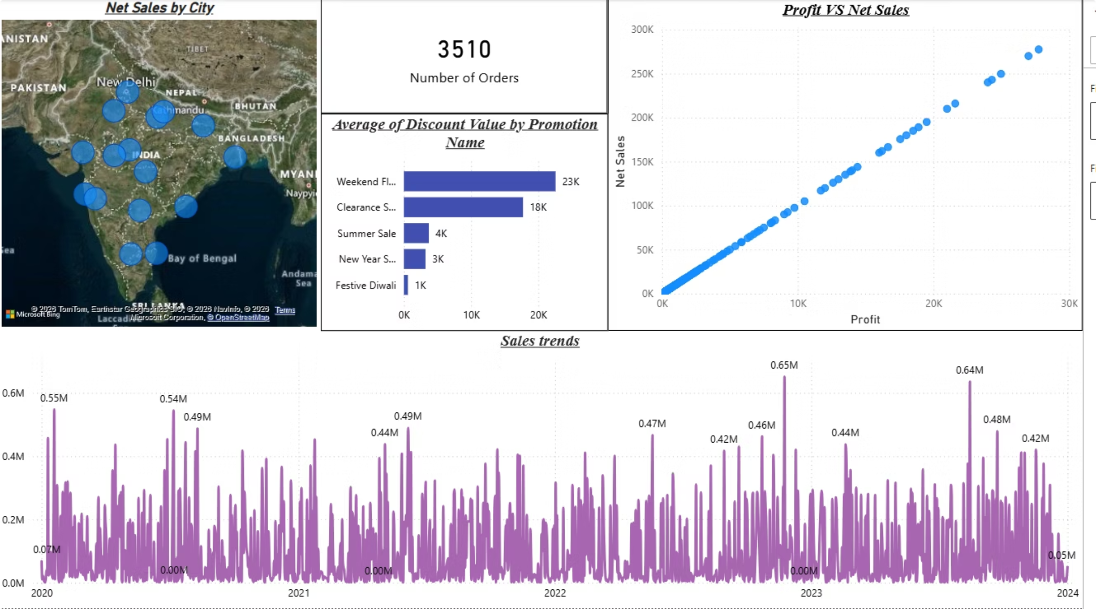
Discount & Regional Insights
Discount Analysis
Highest Discount Promotion
Weekend Flash sale
Average Discount Rate
23K
Regional Performance
🥇 Top Performing City
Bangalore
📍 Lowest Performing City
Nagpur

Slide 9
Project Impact & Conclusion
3000+
4
1
Transactions Analyzed
Integrated Data Tables
Unified BI Dashboard
Project Highlights
Key Takeaway
This dashboard delivers a centralized analytics solution that empowers stakeholders to monitor performance, identify growth opportunities, and make confident, data-driven decisions.
Test-to-production deployment workflow with validated data pipeline
Interactive KPI dashboard with DAX-driven comparative period analysis
Thank You
Sales, profitability & regional insights in a single centralized view

